Slide 1
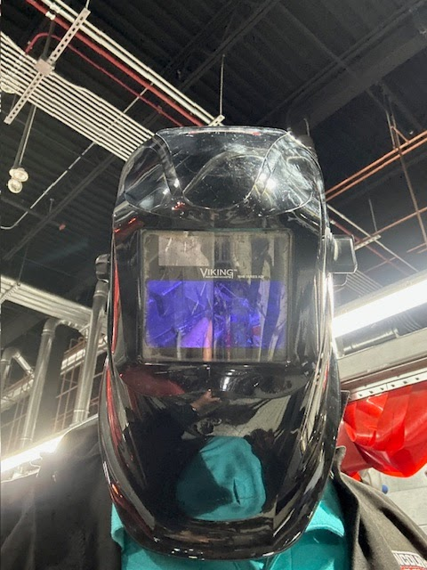
Non-Destructive Testing
NTD Externship Summer 2023
Pennsylvania College of Technology

Slide 2
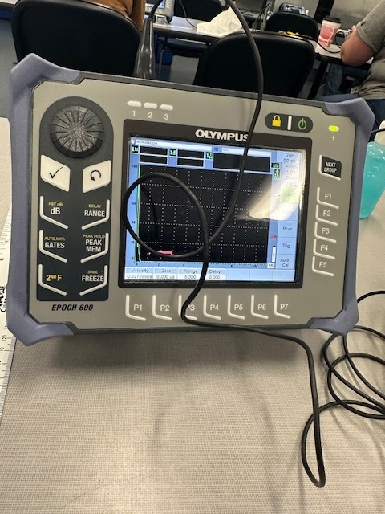
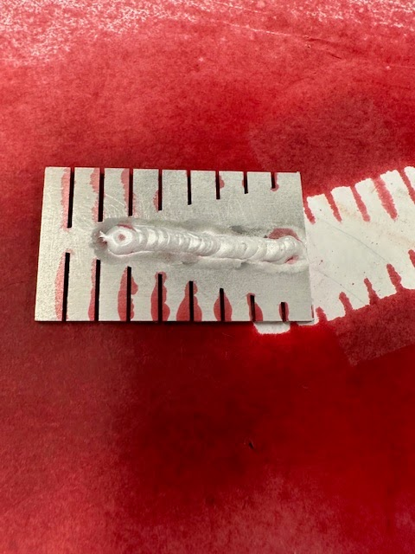
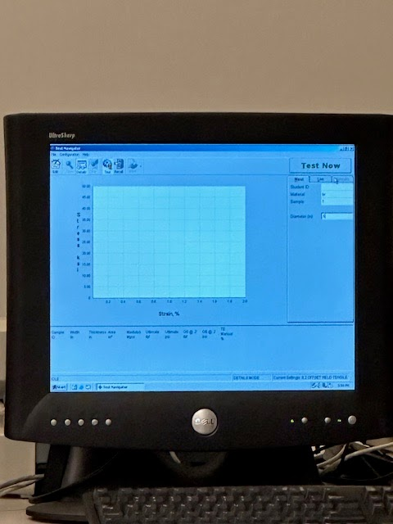
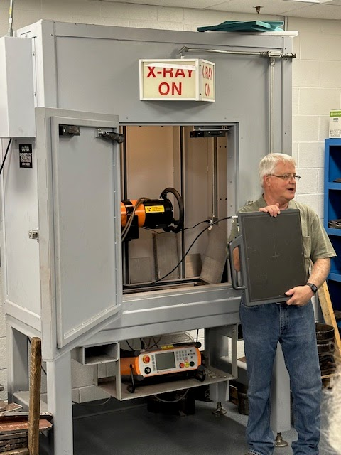
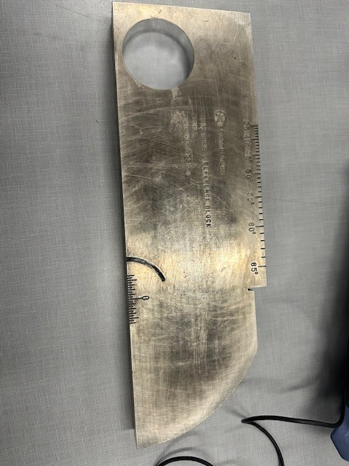
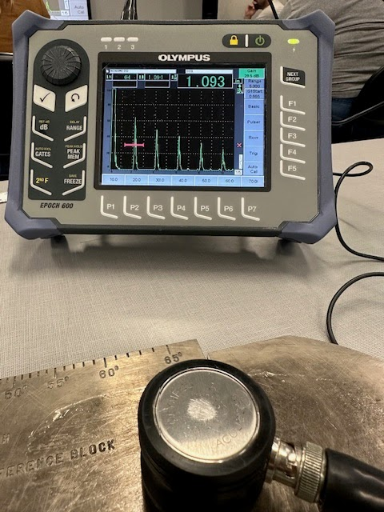
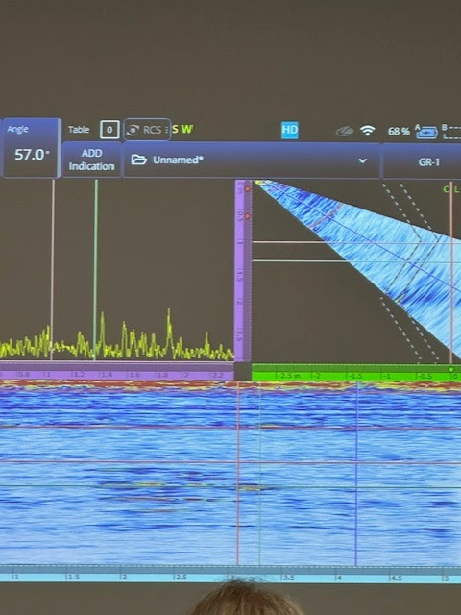
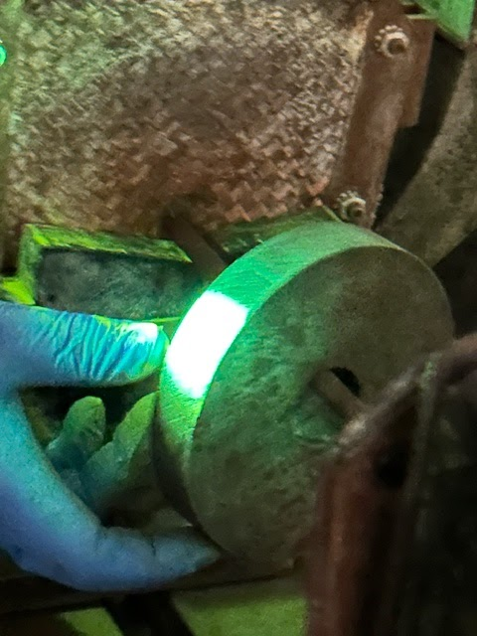
Some of the techniques used to determine structural integrity

Slide 5
Inspections Can be External or Internal
External Inspection: Visual inspection Liquid Penetrant Testing Magnetic Particle Testing | Internal Inspection: Radiography Testing Ultrasonic Testing

Slide 6
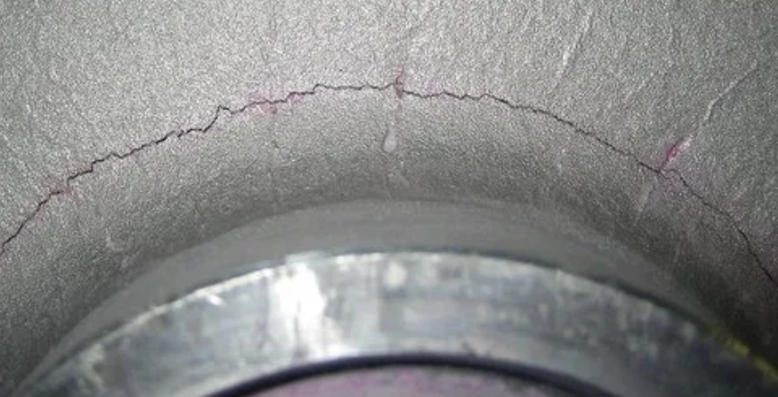
Penetrant Testing
Used to detect surface cracks. Area is flooded with a penetrant, then wiped off. Some of the dye (colored or fluorescent) remains in minute cracks to provide visual data.

Slide 7
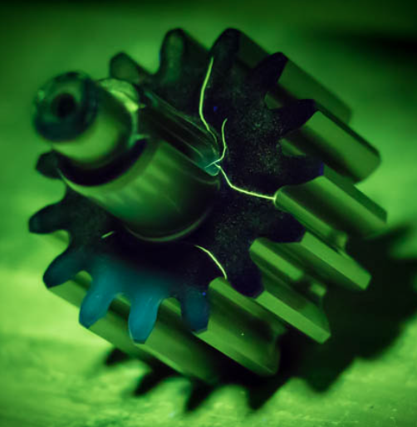
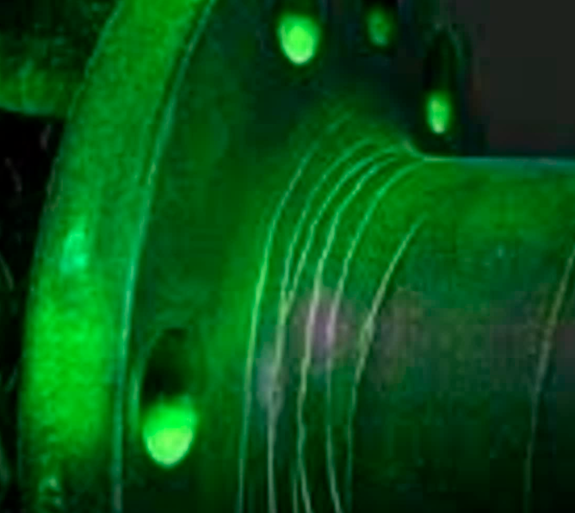
From Summer NDT Externship

Slide 8
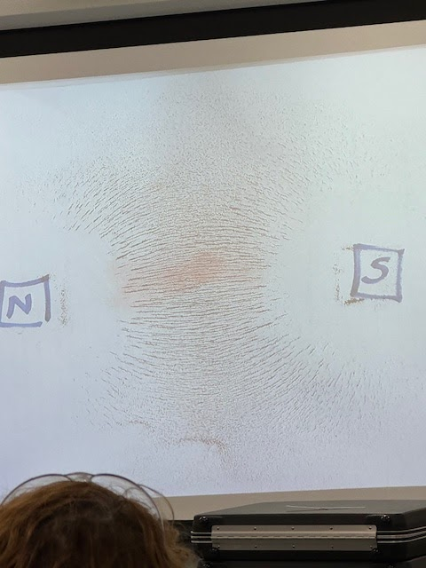
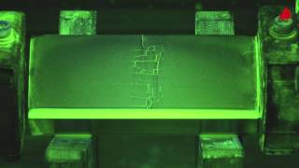
Magnetic Particle Testing
Area is electrically charged to induce a magnetic field. Variations in magnetic field used to indicate structural concern in the material being tested.

Slide 9
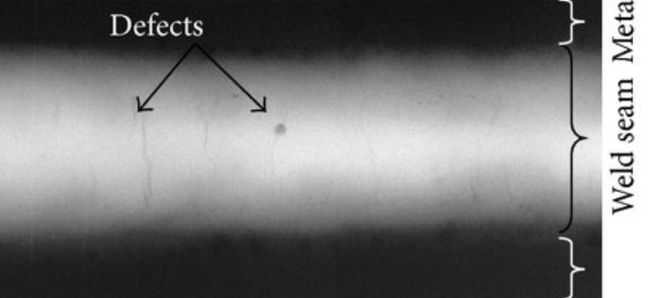
INTERNAL TESTING: Radiography
Have you ever had an X-ray? If yes, then you already know the basics of this NDT. A radiation source is used to pass radiation through a sample object and an image is created. This image can show defects inside of materials.

Slide 10
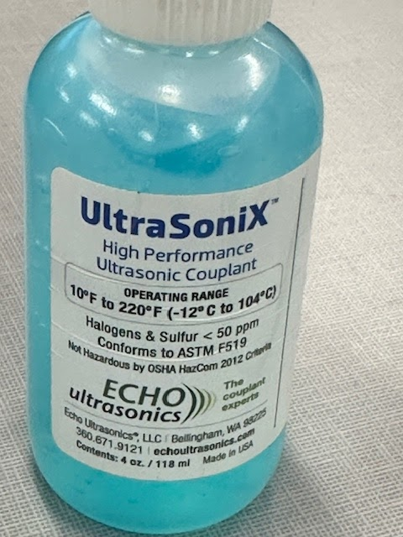
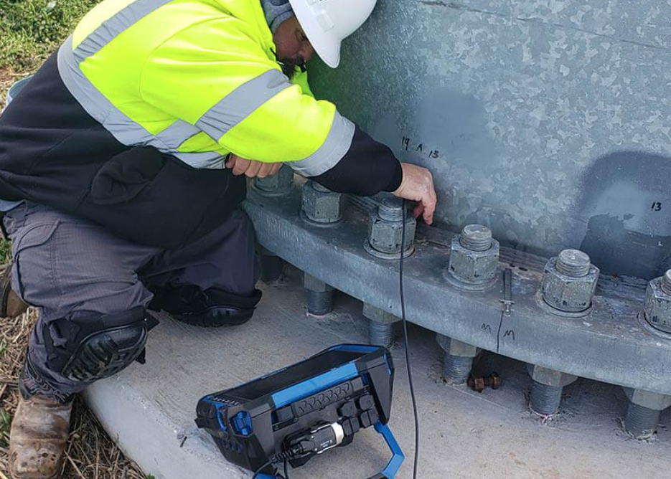
Internal Testing: Ultrasonic Testing
Uses penetrating soundwaves like SONAR to create images that can show internal defects

Slide 11
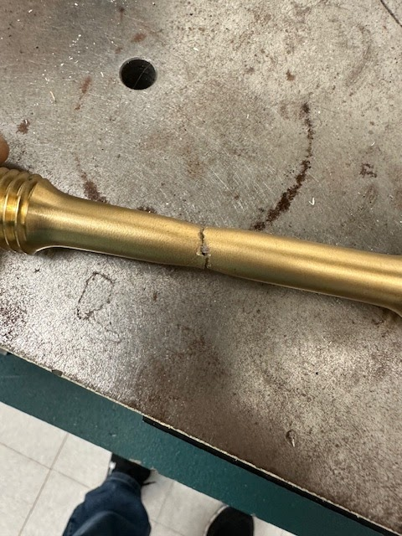
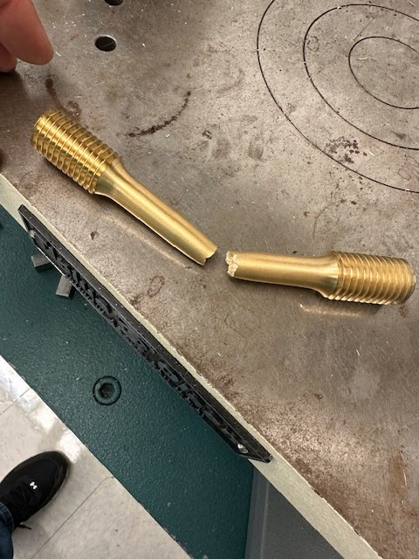
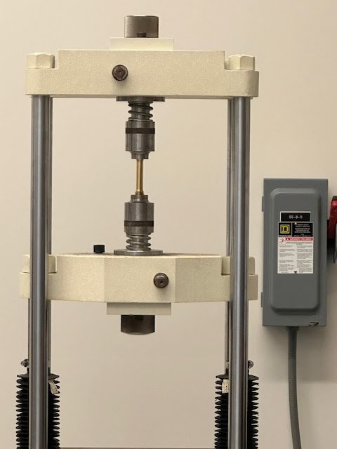
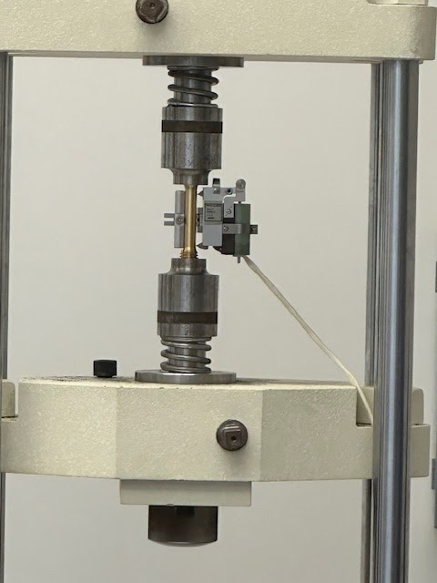
Tensile Strength Testing
DESTRUCTIVE TESTING

Slide 12
Students interested in a career within NDT typically require a specialized program such as those offered my technical schools such as Pennsylvania College of Technology (Williamsport, PA).. They even offer several inexpensive summer experiences/camps for interested high school students.

