Slide 1
NON-DESTRUCTIVE TESTING

Slide 2
What is NDT?

Slide 3
What is NDT?
Non-Destructive Testing: Methods to analyze the properties and structures of materials without damaging the components being evaluated.
Also known as:
NDE (Non-Destructive Evaluation/Examination)
NDI (Non-Destructive Inspection)

Slide 4
What are some of the defects we try to detect?

Slide 5
What are some of the defects we try to detect?
Cracks
Heat stress
Shrinkage
Hydrogen
Porosity
Welding
Casting
Lack of fusion
Solid Inclusions
Cold shuts
Lack of penetration
Laps or seams
Wrought processing

Slide 6
What industries use NDT?

Slide 7
What industries use NDT?
Aerospace
Marine (propellers)
Nuclear
Infrastructure
Petroleum

Slide 8
NDT Levels of Qualification
Level 1:
Ability to perform specific calibrations, tests, and evaluations according to written instructions.
Level 2:
Ability to setup and calibrate equipment, interpret and evaluate results in accordance with codes, standards, and specifications. Report results.
Level 3:
Establish techniques, interpret codes, designate test methods and techniques used. Possess practical background in technology and familiarity with methods of NDT.

Slide 9
What are some of the methods?

Slide 10
What are some of the methods?
Visual Inspection
Leak Testing
Magnetic Particle
Dye Penetrant
Ultrasonic
Eddy Current
Radiographic

Slide 11
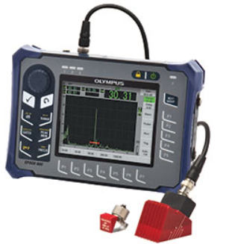
Introduction to Ultrasonic Testing
Medical Application
Industrial Application

Slide 12
Ultrasonic inspection is used in many applications to ensure product safety and reliability.

Slide 13
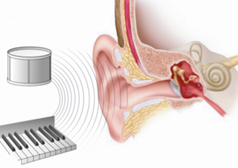
What is ultrasound and how does it work?
Ultrasound waves are acoustic energy above the human hearing range.
The human ear can detect sounds of up to 20,000 hertz.
Soundwaves move through many different materials by means of particle displacement in the molecular structure.

Slide 14
Velocity of sound energy within material
Sound waves travel through material by transferring mechanical energy from one atom to the next as detailed in this simple illustration.
The more densely packed the atoms are arranged, the faster the sound energy travels through the material.

Slide 15
The typical Pulse-echo instrument technique

Slide 16
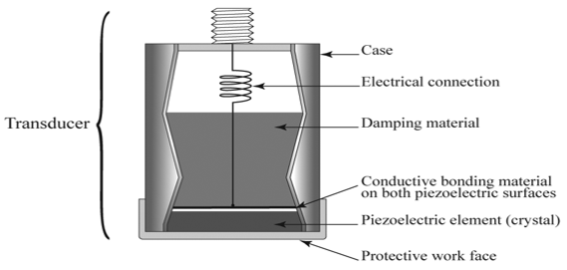
The makeup of an ultrasonic transducer
The transducer must be able to perform two functions:
Convert electrical energy to mechanical energy.
Convert mechanical energy to electrical energy.

Slide 17
Ultrasonic wave modes
Ultrasonic waves can be categorized in four different wave modes. Each wave mode has a different effect on the particle displacement and limitations when performing various inspections.
Longitudinal (Compression) waves
Shear (Transverse) waves
Surface (Raleigh) waves
Plate (Lamb) waves

Slide 18
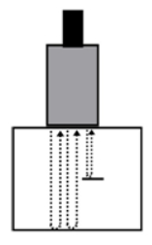
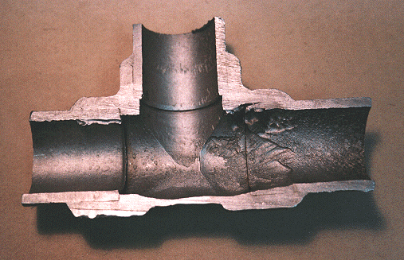
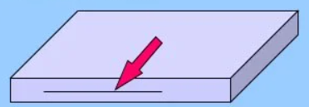
Longitudinal or Compression waves
Primarily used to determine:
material soundness examinations
Material thickness examinations

Slide 19
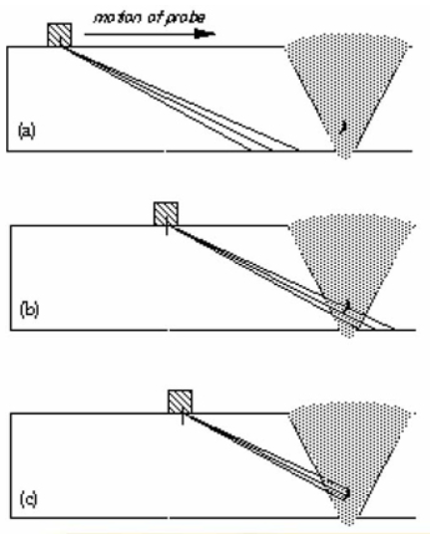
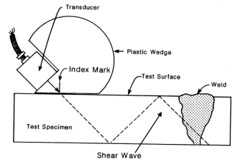
Shear or Transverse waves
Primarily used to detect small discontinuities in material. This wave type is typically used to inspect welds for flaws.

Slide 20
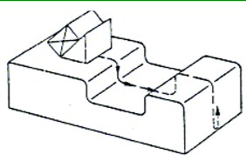
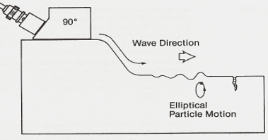
Surface or Raleigh waves
Used to test surface discontinuities in material.

Slide 21
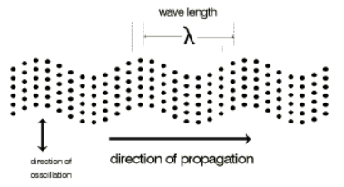
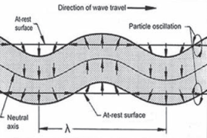
Plate or Lamb waves
Used to ultrasonically inspect thin gage sheet material for discontinuities.

Slide 22
Sound
Longitudinal Wave

Slide 23
Pitch
Determined physically by frequency
“Audible Range” = 20 to 20000 Hz
Above 20,000Hz, ultrasonic
Below 20Hz, infrasonic

Slide 24
Graphing Compression Waves

Slide 25
Sound Pitch, Graphically

Slide 26
Wind Instruments
Cause sound by standing waves in a column of air
Vibration caused by reed, player’s lips, or turbulence

Slide 27
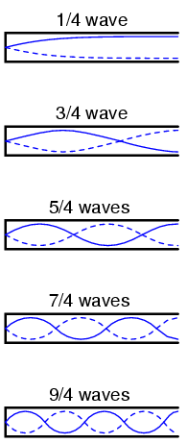
Closed at One End
D
L
For ¼ wave:
V = wavelength x frequency
Wavelength = 4(L + 0.4D)

