Slide 1
Penn College NOW
Application Process 2020-2021

Slide 2
Penn College NOW
Offered in 8 NTCC Programs:
Building Construction
Diesel Technology
Food Production and Management
HVAC/Mechanical Trades
Information Technology
Machine Tool Technology
Pre-Nursing Year 1
Welding Technology
2017-2019: 691 credits
No cost to students
Families saved $377,662 in tuition
Notes:
Ways to earn college credits at NTCC

Slide 3
https://www.pct.edu/PCNOW
Every student must
apply every year
to participate!
All steps must be completed to be enrolled.

Slide 4
Registration
I already have a Penn College NOW account
This will be my first Penn College NOW course

Slide 5
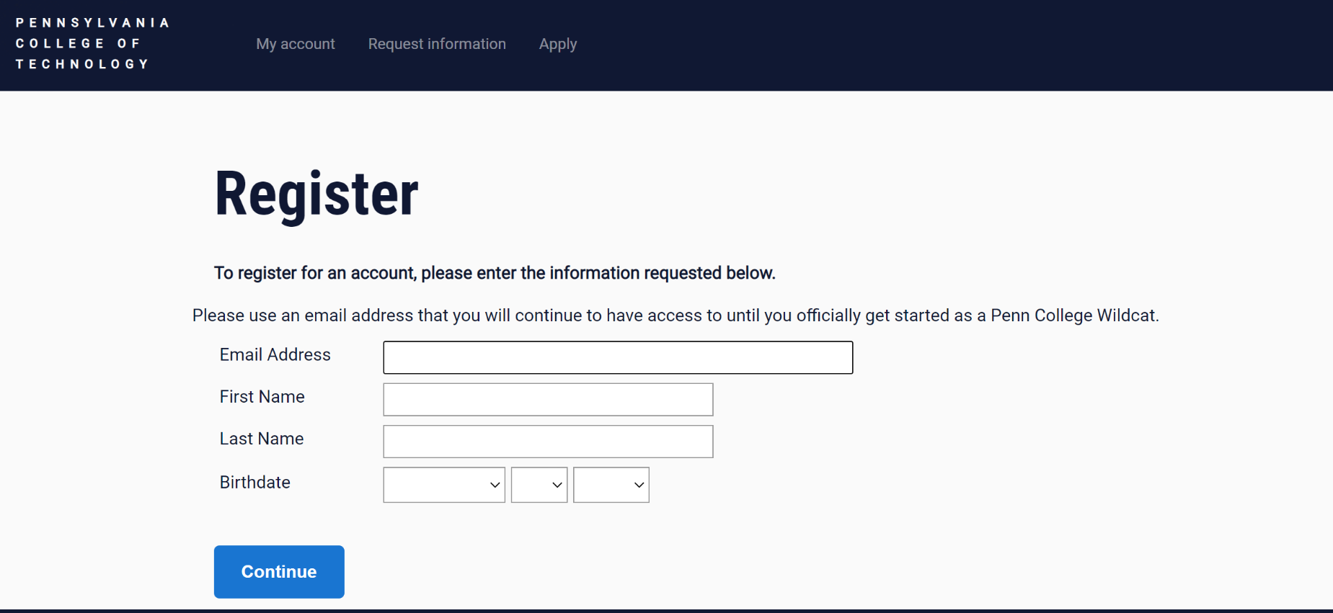
Create an account
Email address
Personal (appropriate)
School
First name
Last name
Date of birth

Slide 6
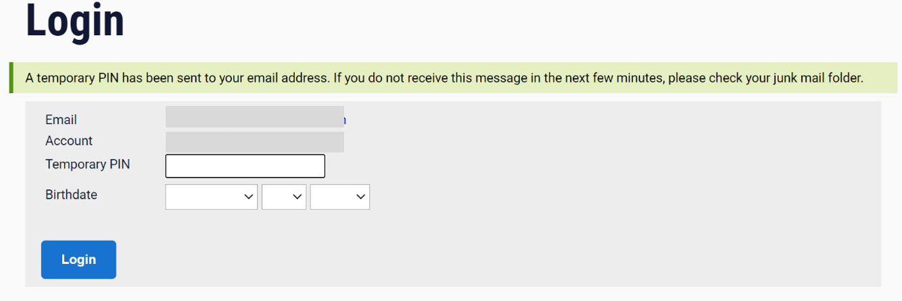
Account activation email
Click link in email
Enter temporary PIN from email & date of birth

Slide 7
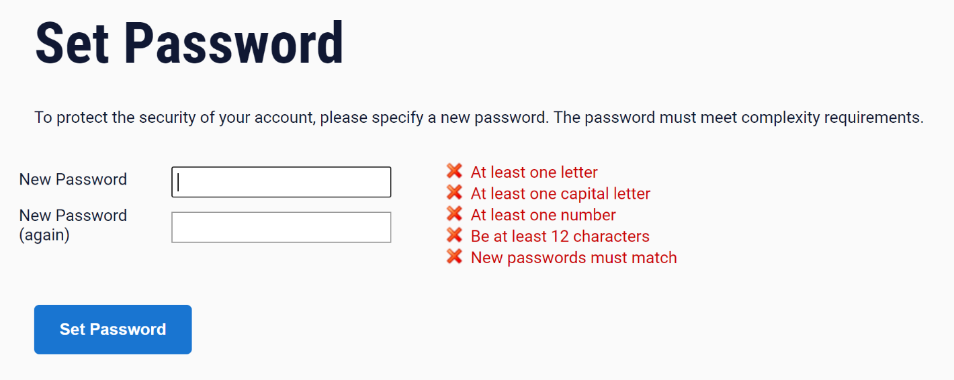
Create password
Create password
Follow guidelines in RED
Save your password!
Write it down
Click the to view password and save a screenshot or pic in your phone
This will appear after you’ve entered the password
You are registered, but still MUST apply!

Slide 8
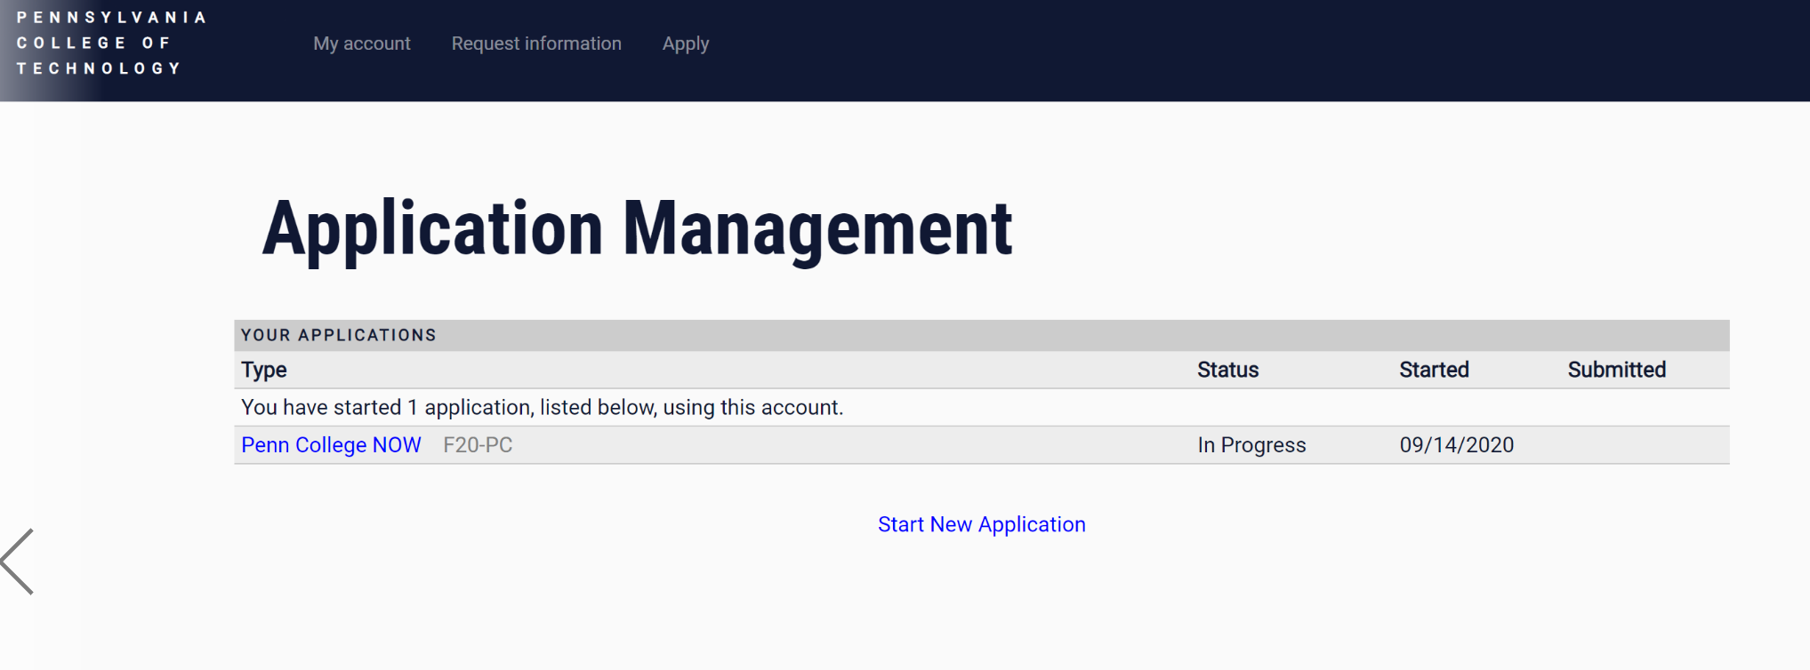
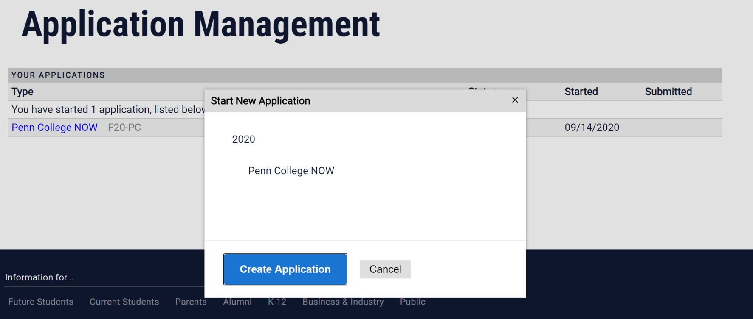
Application

Slide 9
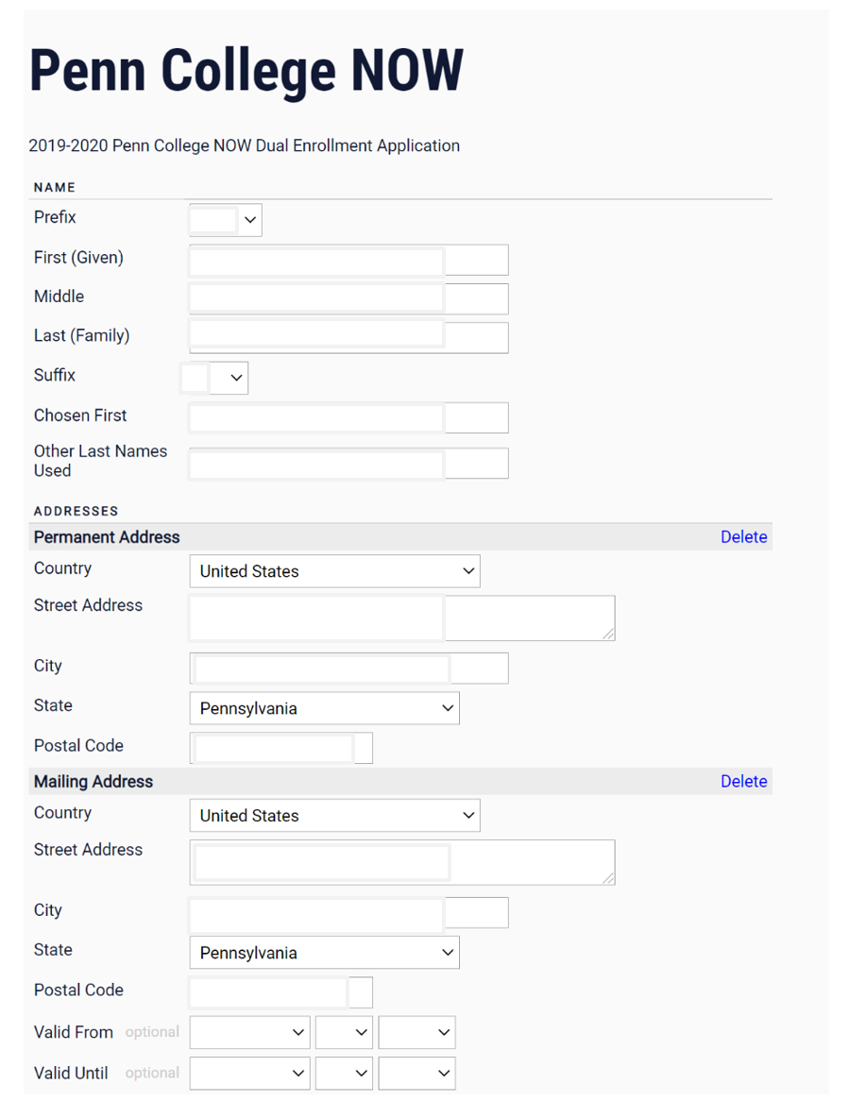
The first name you go by or prefer to be called.
Leave blank

Slide 10
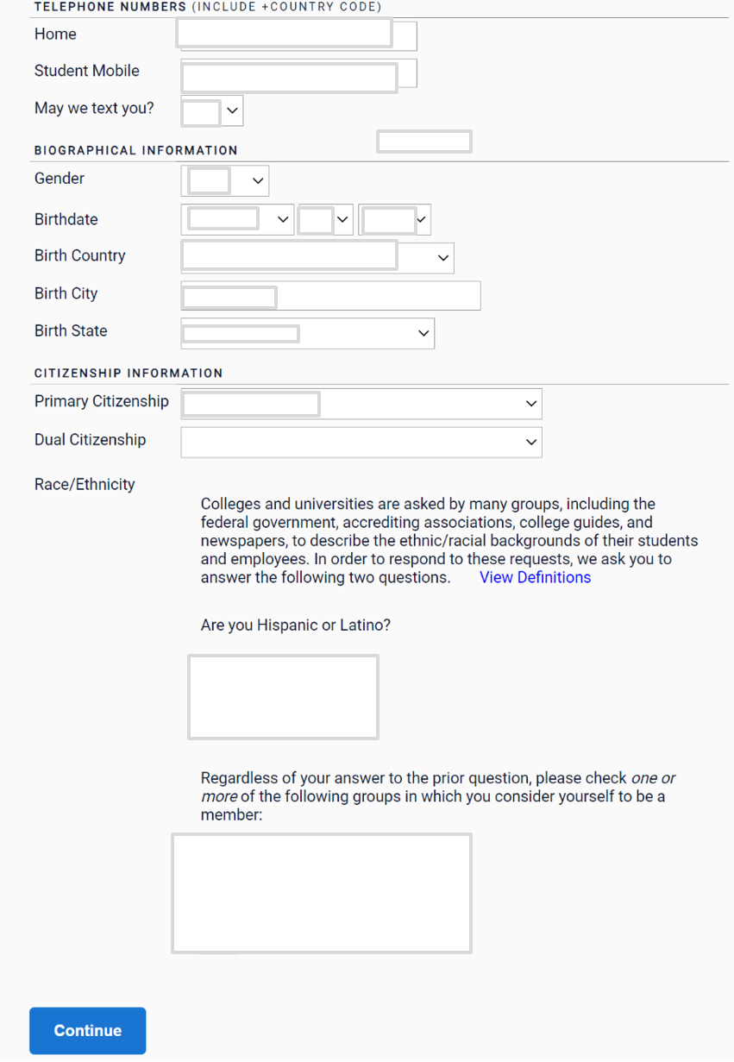
Country where you are a citizen
Only if you are a citizen of more than one country

Slide 11
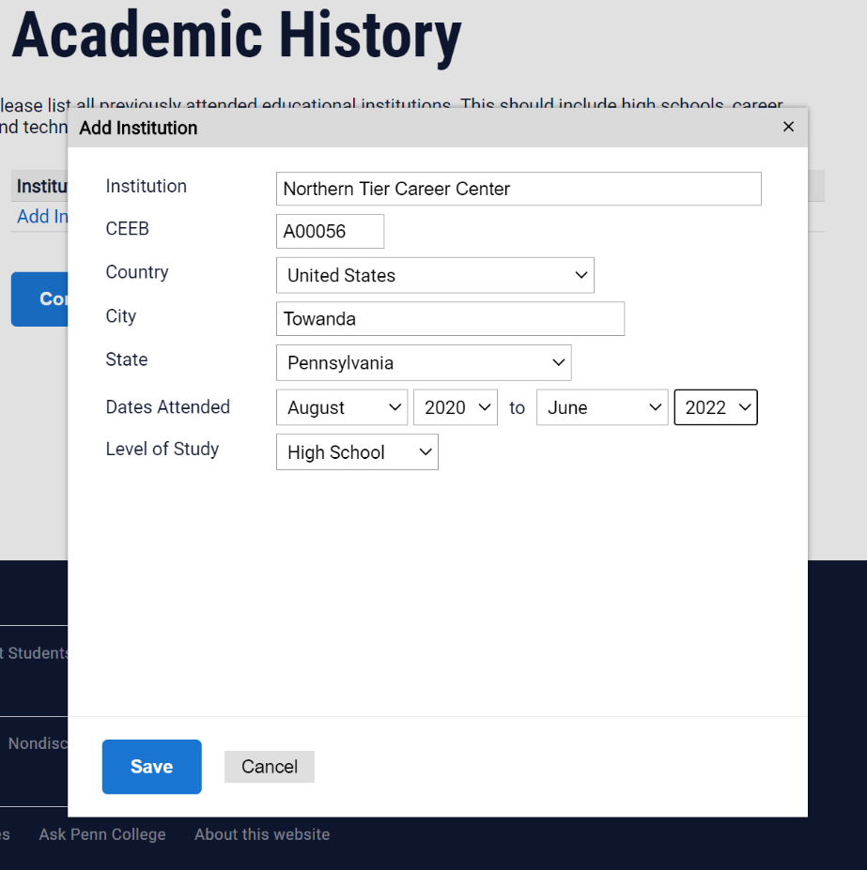
Step 1
Begin typing & the information will auto-fill
Step 2
Date you entered the school to anticipated graduation date
Step 3
Add Institution & repeat with your high school information

Slide 12
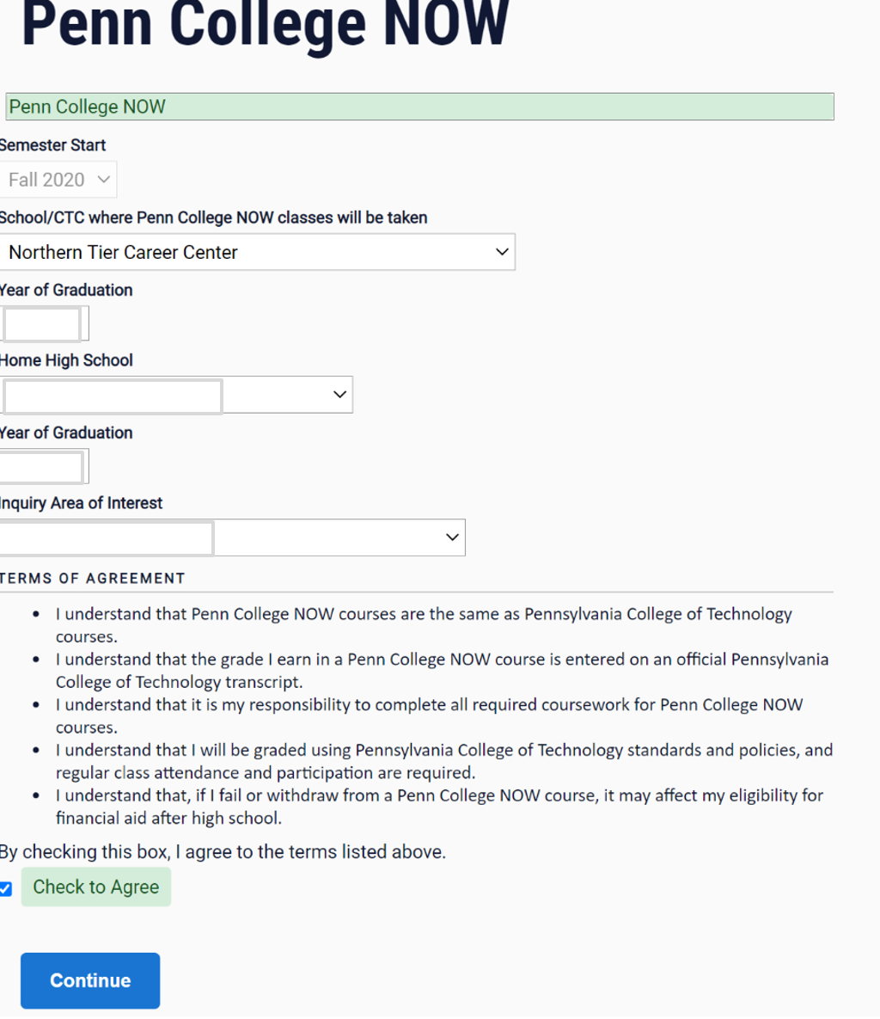
Complete this page with your NTCC & high school information.

Slide 13
e-sign

Slide 14
SUBMIT!
You may be prompted to make sure you’re ready to submit.
If you are, click OK.
If not, review your application, then submit.
The application MUST be submitted in order for you to be enrolled!

Slide 15
Confirmation
You will receive a confirmation email from Penn College.
Next steps will be provided by your instructor.
If you have not received a confirmation email, your application is not complete/submitted!

Slide 16
Congratulations on completing this important step toward your future goals!
Questions: Please contact your instructor or Mrs. Farley at 570-265-8111 or jfarley@ntccschool.org.

