Slide 1

NDT: Magnetic Particle testing

Slide 2


in this lesson we will….
Identify the various types of discontinuities detectable by MPT, such as surface cracks, seams, laps, and inclusions.
Gain awareness of safety precautions and procedures associated with MPT, including handling of equipment, personal protective equipment (PPE), and environmental considerations.
Demonstrate knowledge of the equipment used in MPT, including magnetizing equipment, magnetic particles, and inspection media.

Slide 3
But First?
What is a discontinuitie? How do you think we can use a magnet to test for them?

Slide 4
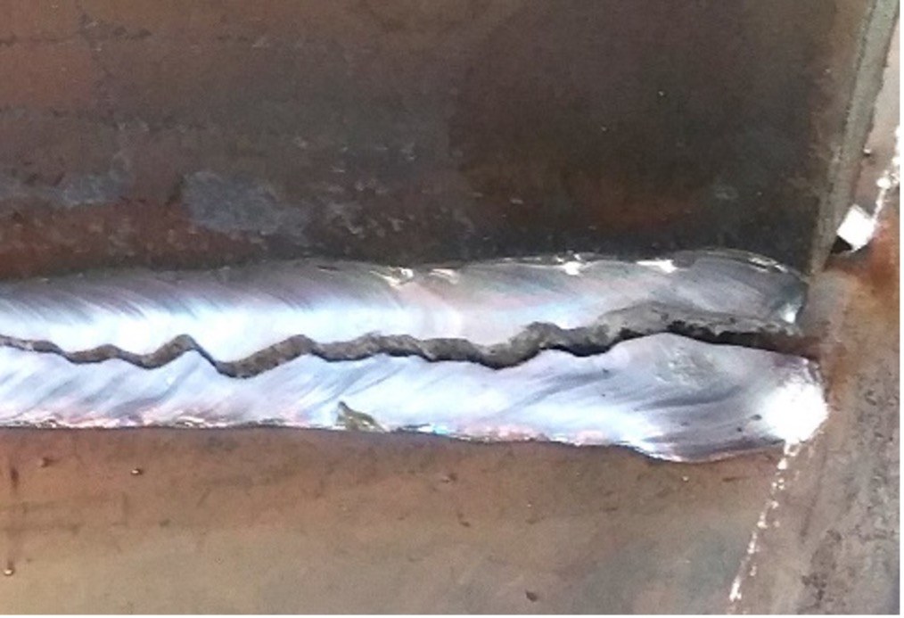
discontinuities
When we talk about nondestructive testing (NDT) methods like magnetic particle testing, we're checking materials for any bumps, breaks, or weird spots without causing damage. These weird spots are called "discontinuities." Discontinuities can be different things, like cracks, holes, or parts that didn't get made right. They can happen when something is being made, if the material has problems, or if it's not put together right. Discontinuities can also pop up later because of stress, rust, or just from being used a lot.

Slide 5
PPE
Eye Protection: Wear safety glasses or goggles to shield your eyes from particles and splashes.
Hand Protection: Use chemical-resistant gloves to protect against chemicals and sharp edges.
Skin Protection: Cover up with long sleeves and pants to shield your skin.
Footwear: Wear sturdy, closed-toe shoes with non-slip soles for foot protection.

Slide 6
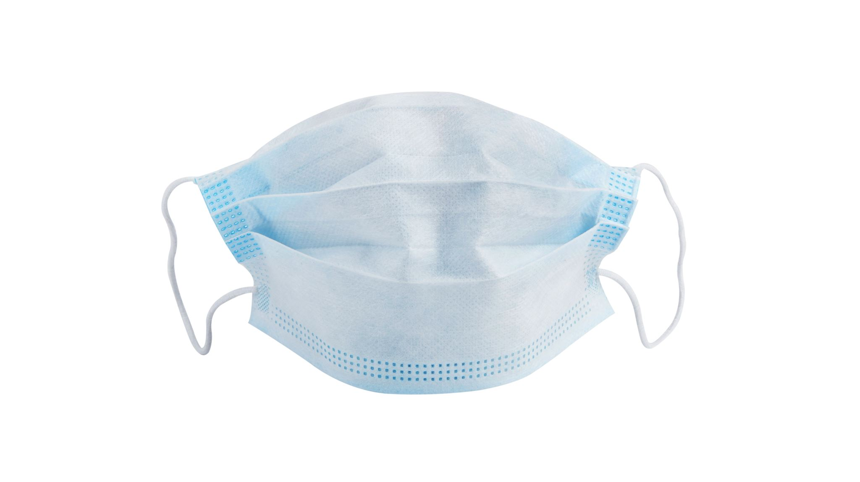
Other PPE
Respiratory Protection: Wear dust masks or respirators when in confined spaces or handling aerosolized particles.

Slide 7
First
Preparation:
Choose the right magnetic particle testing method for the component.
Ensure the inspection area is clean, well-lit, and safe.
Gather equipment and personal protective gear.
Surface Preparation:
Clean the component surface thoroughly.
Ensure the surface is dry and free of any cleaning agents.

Slide 8
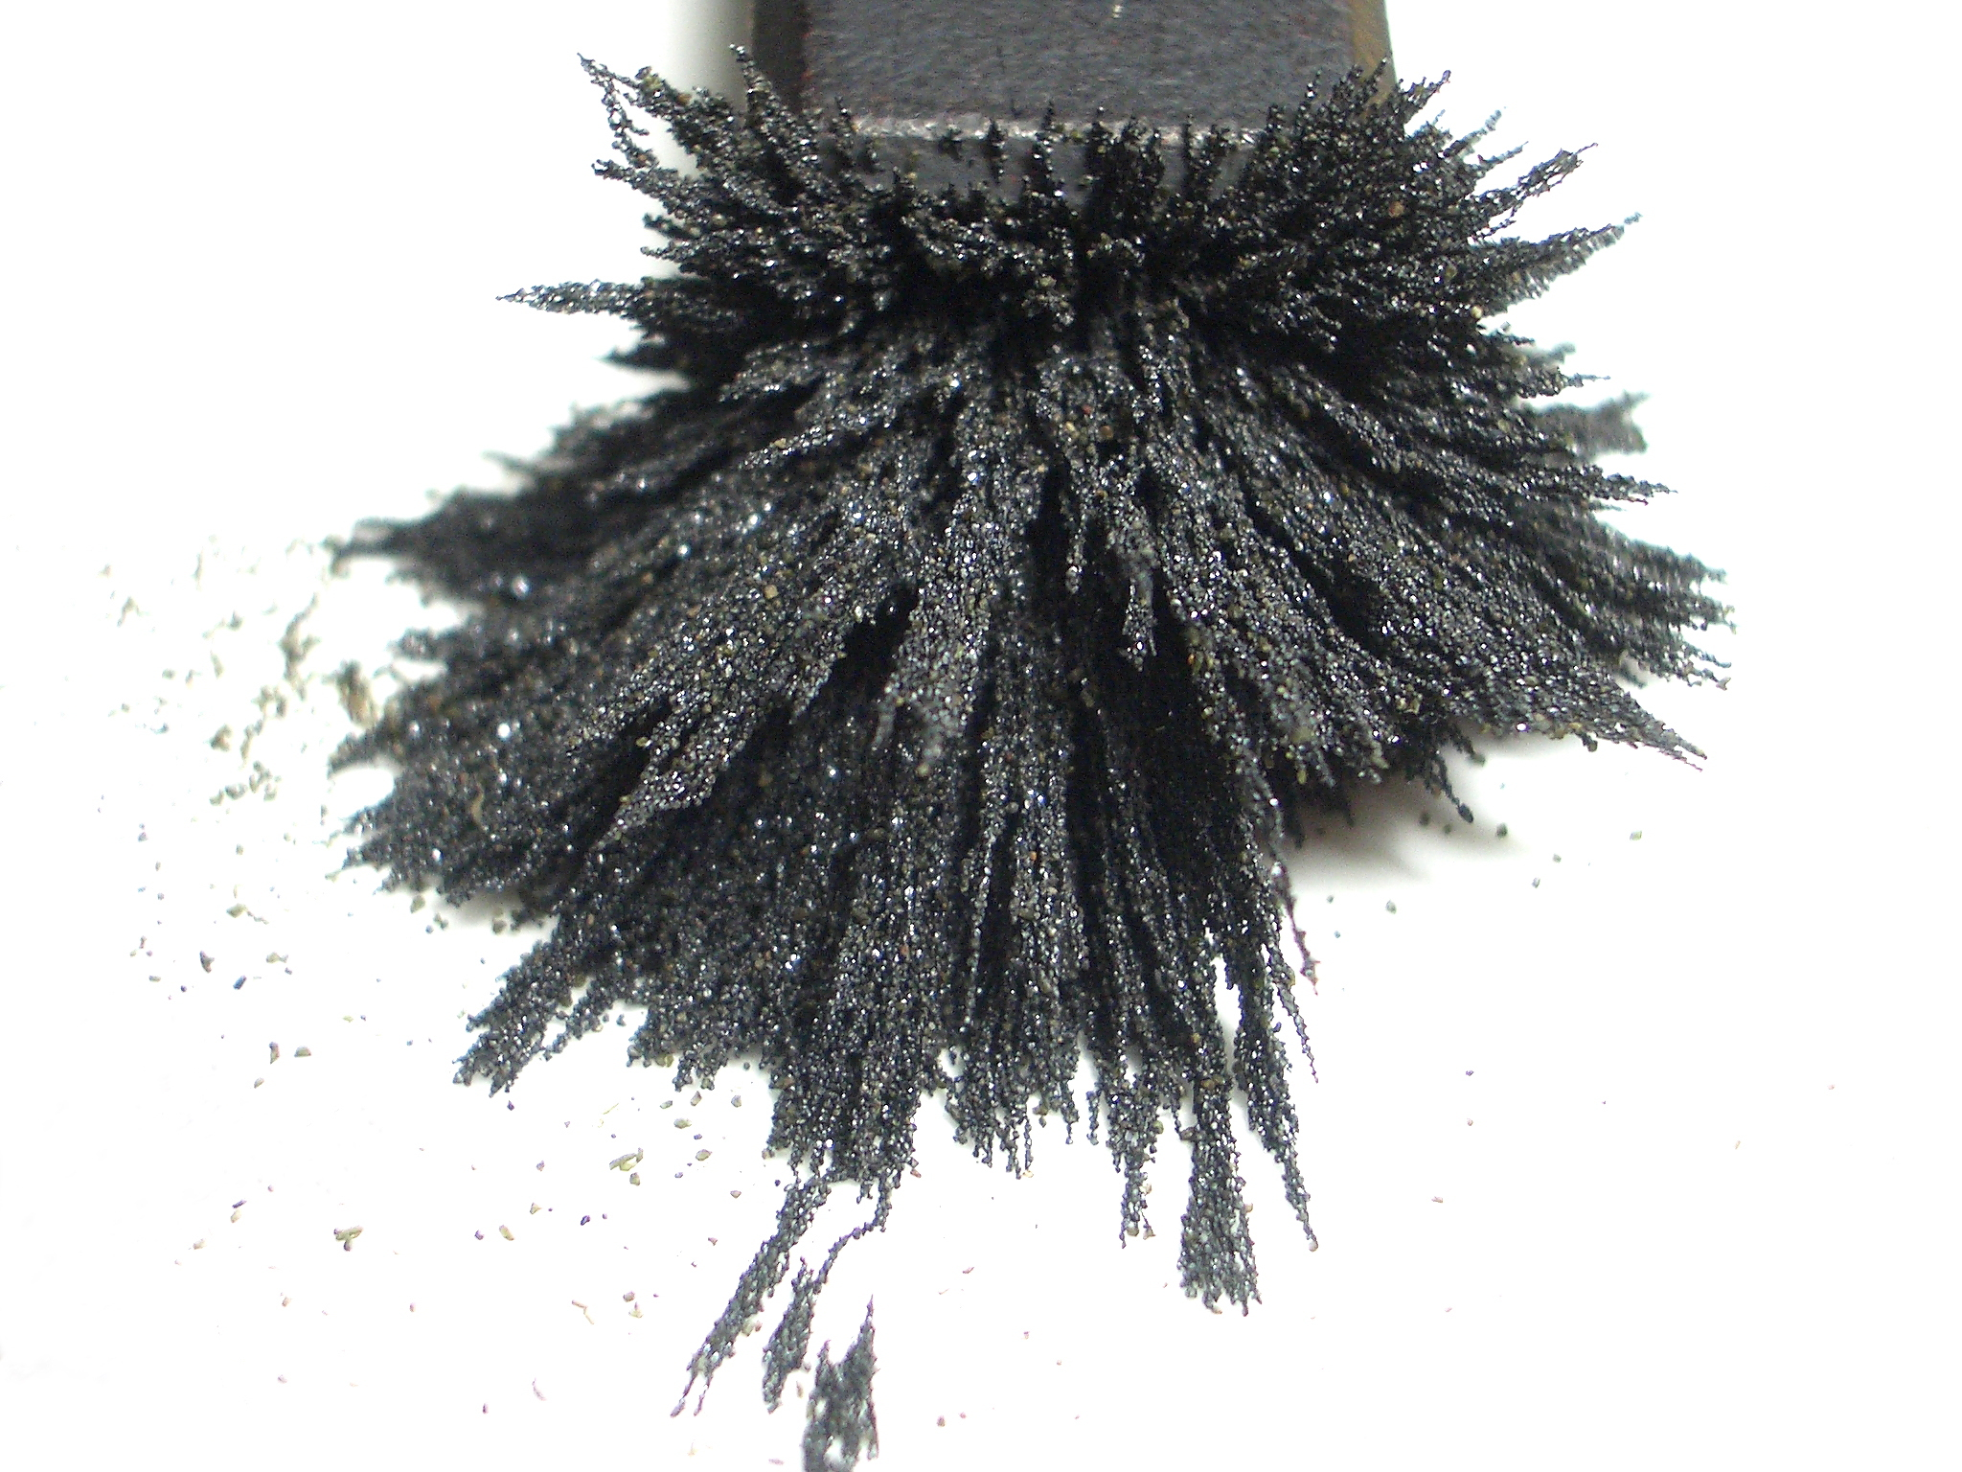
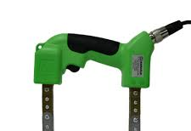
Magnetic Yoke & Magnetic Particles

Slide 9
Then
Magnetization:
Select the appropriate magnetization technique.
Position and apply the magnetic field properly.
Application of Magnetic Particles:
Apply particles while the magnetic field is present.
Disperse particles evenly over the surface.

Slide 10
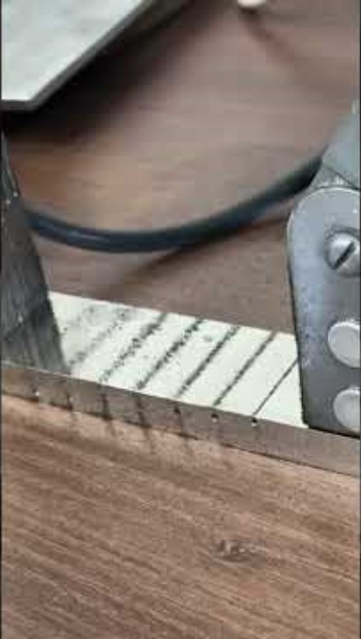
How its done

Slide 11

After
Inspection:
Visually inspect under suitable lighting.
Verify magnetic field strength.
Note indication characteristics.
Evaluation:
Determine if indications are real or false.
Consider size, shape, and location.
Document results for analysis.

Slide 12
Finally
Post-Inspection Procedures:
Clean surface to remove particles.
Demagnetize the component.
Review results and take necessary actions.

Slide 13

Whos Ready to try it out??

