Slide 1



Summer Fun at Penn College of Technology (July 2023)

Slide 2
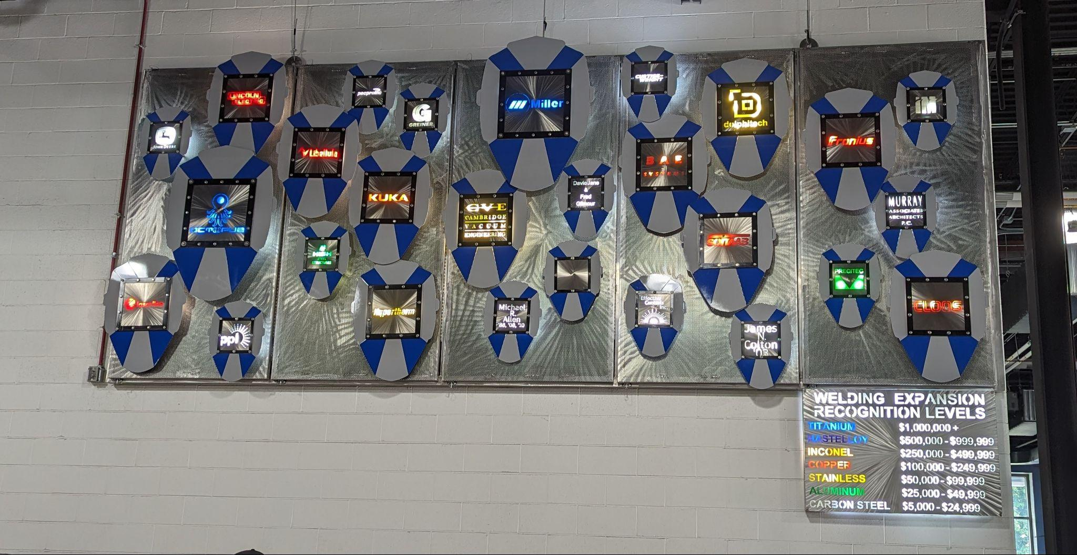
Industry Partners

Slide 3
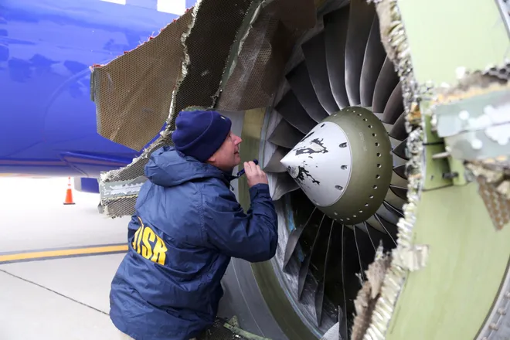
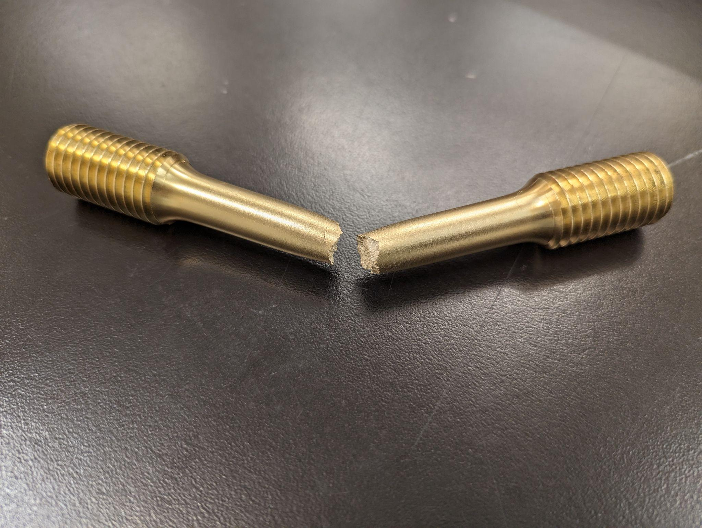
Two types of Testing Materials
Non-Destructive (NDT) is used to collect information about material in ways that do not alter it (i.e. without destroying it)
What types of things would you want to test for strength without destroying it?
Destructive Testing (DT) is used to collect information about material in ways that alter it (i.e destroy it).
What are some things that might be okay to destroy?

Slide 4
Nondestructive Testing
A variety of non-invasive processes that allow technicians to carefully inspect and certify the integrity and safety of objects like vehicles, bridges, pipelines, and airplanes.

Slide 5
Types of Nondestructive Testing
Visual (VT)
Ultrasonic (UT)
Radiography (RT)
Eddy Current (ET)
Magnetic Particle (MT)
Acoustic Emission (AE)
Dye Penetrant (PT)
Leak Testing (LT)
Notes:
https://www.flyability.com/ndt

Slide 6
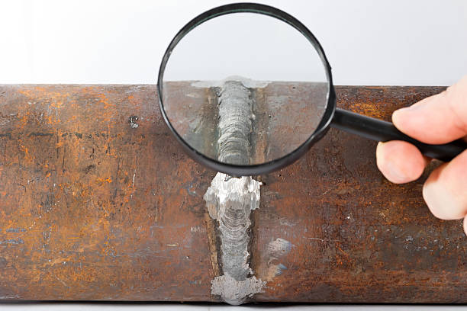
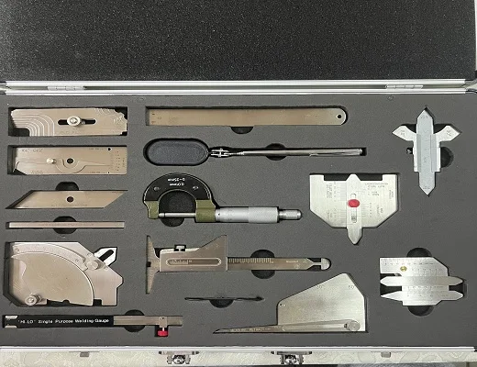

Visual Inspection (VT)
The act of collecting visual data on the status of a material.
Notes:
https://esab.com/us/nam_en/esab-university/blogs/visual-inspection-of-welded-connections/#:~:text=What%20Is%20Visual%20Inspection%20of,by%20an%20experienced%20welding%20inspector.

Slide 7
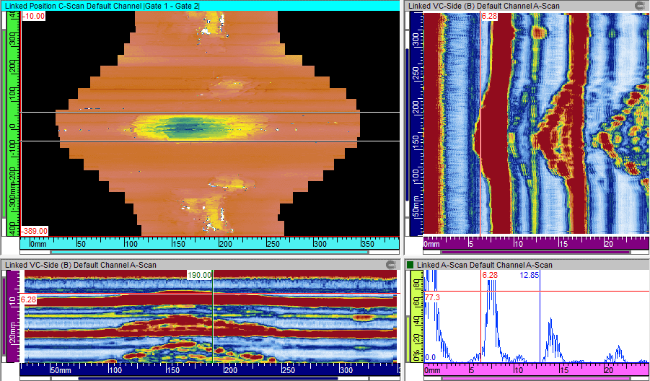
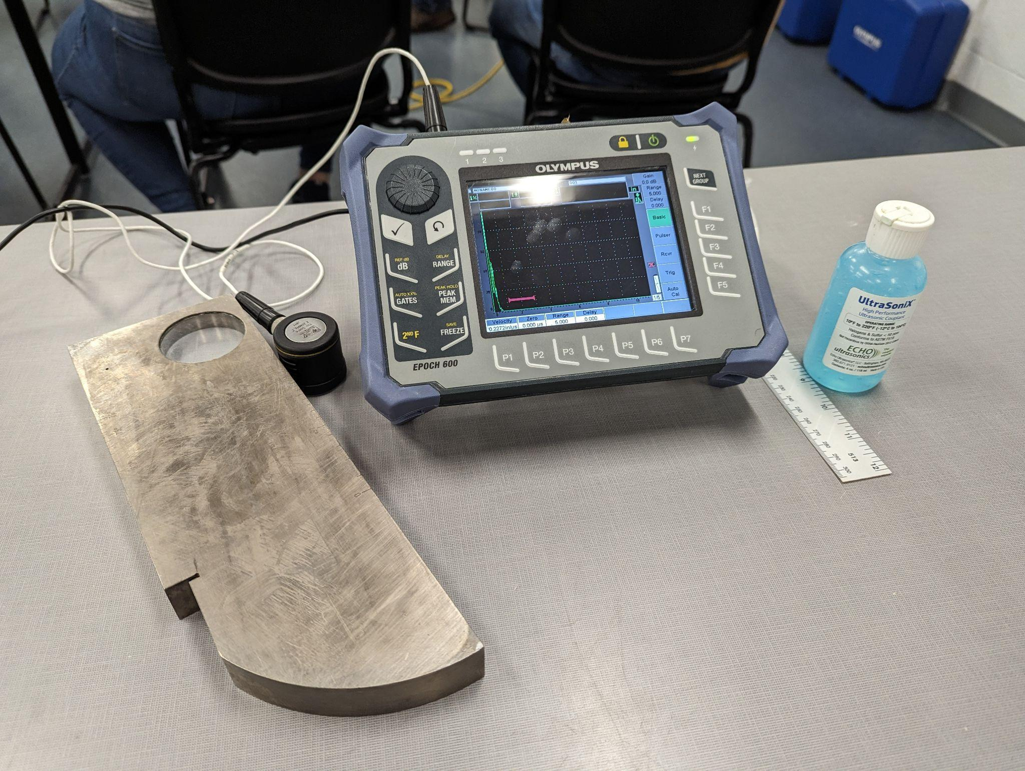
Ultrasonic (UT)
The process of transmitting high-frequency sound waves into a material in order to identify changes in the material’s properties.
Notes:
https://www.twi-global.com/technical-knowledge/faqs/ultrasonic-testing#:~:text=Ultrasonic%20testing%20(UT)%20comprises%20a,material%20or%20for%20flaw%20detecting.

Slide 8
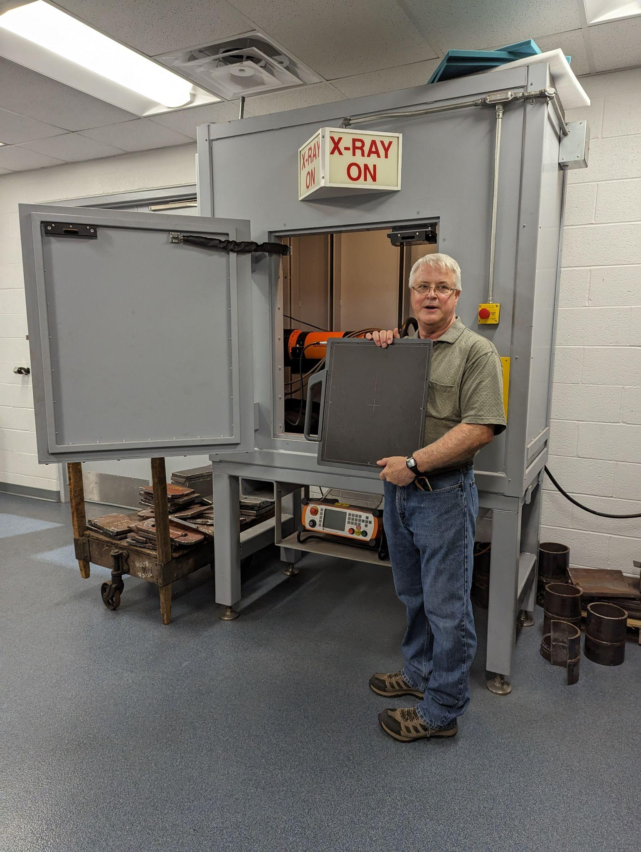
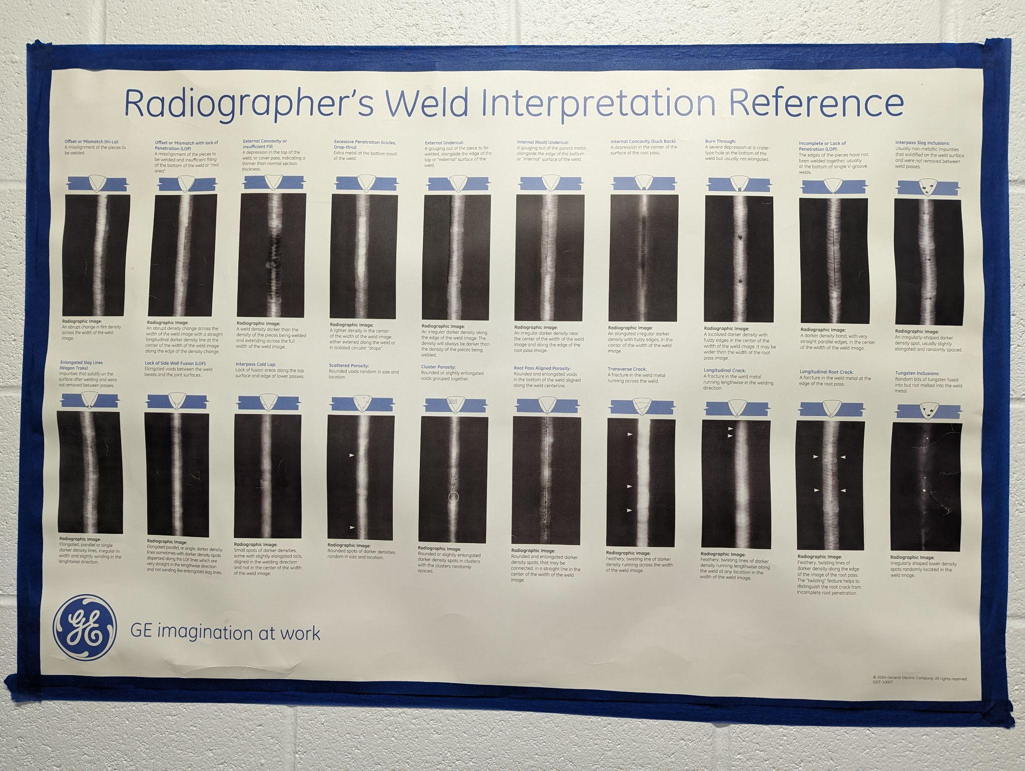
Radiography (RT)
The act of using gamma or X-radiation on materials to identify imperfections.
Notes:
https://www.trainingndt.com/what-is-radiography-in-ndt/

Slide 9
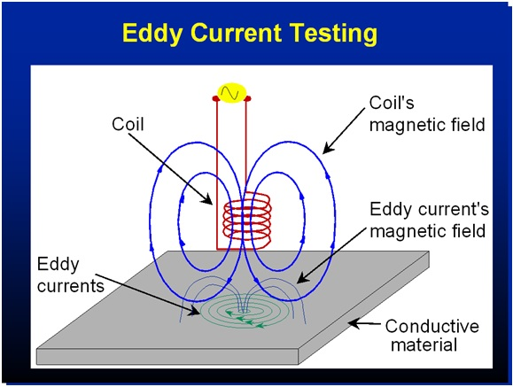
Eddy Current (ET)
Uses electromagnetic induction to identify defects
Testing with Eddy Current - Explained simply
https://youtu.be/89xtM0yeq6A?si=py2fZ08rkvIRtzRZ
Notes:
https://www.merrickgroupinc.com/articles/what-is-eddy-current-testing/

Slide 10
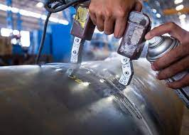
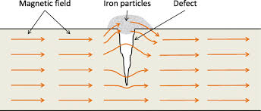
Magnetic Particle (MT)
The act of identifying imperfections in a material by examining disruptions in the flow of the magnetic field within the material.
https://youtu.be/93sRATwdHo4?si=NBz82NL4uAW2160Q
Notes:
https://www.sisco.kobelco.com/english/service/nondestructiveness/mt.html#:~:text=Magnetic%20particle%20Test%20(MT)%20is,appeared%20on%20the%20test%20piece.

Slide 11
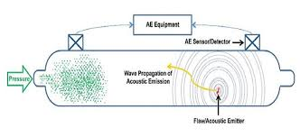
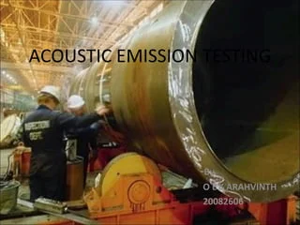
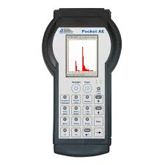
Acoustic Emission Testing (AE)
An inspection method that uses the release of ultrasonic stress waves to identify defects in materials.
Notes:
https://www.flyability.com/acoustic-emission-testing

Slide 12
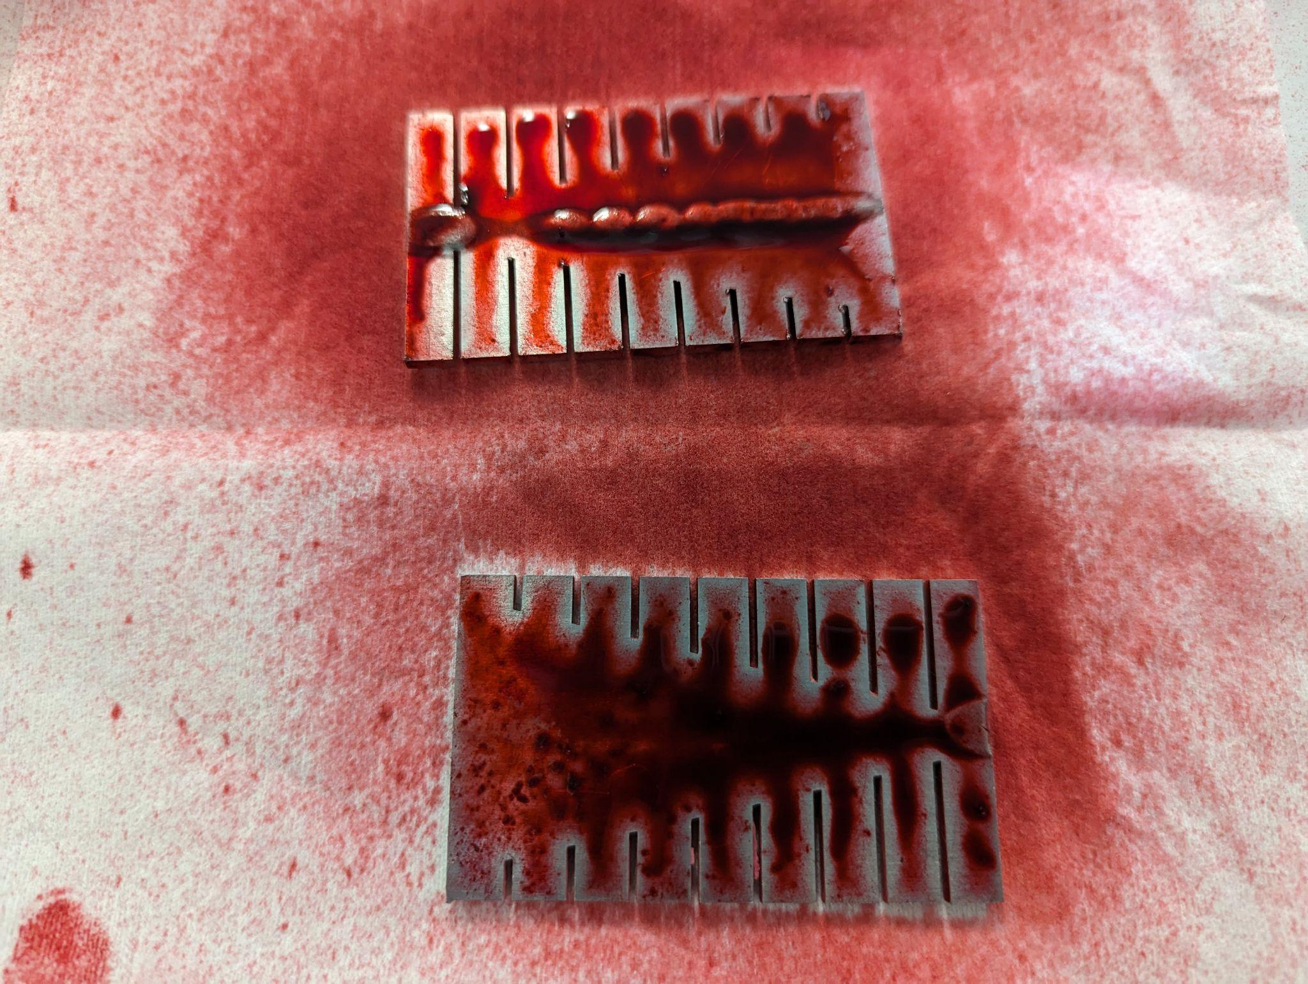
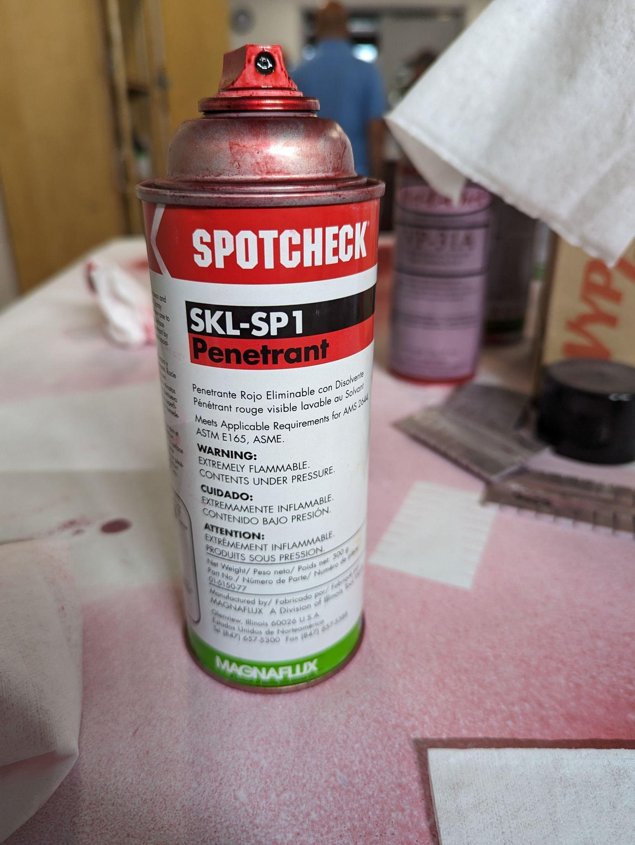
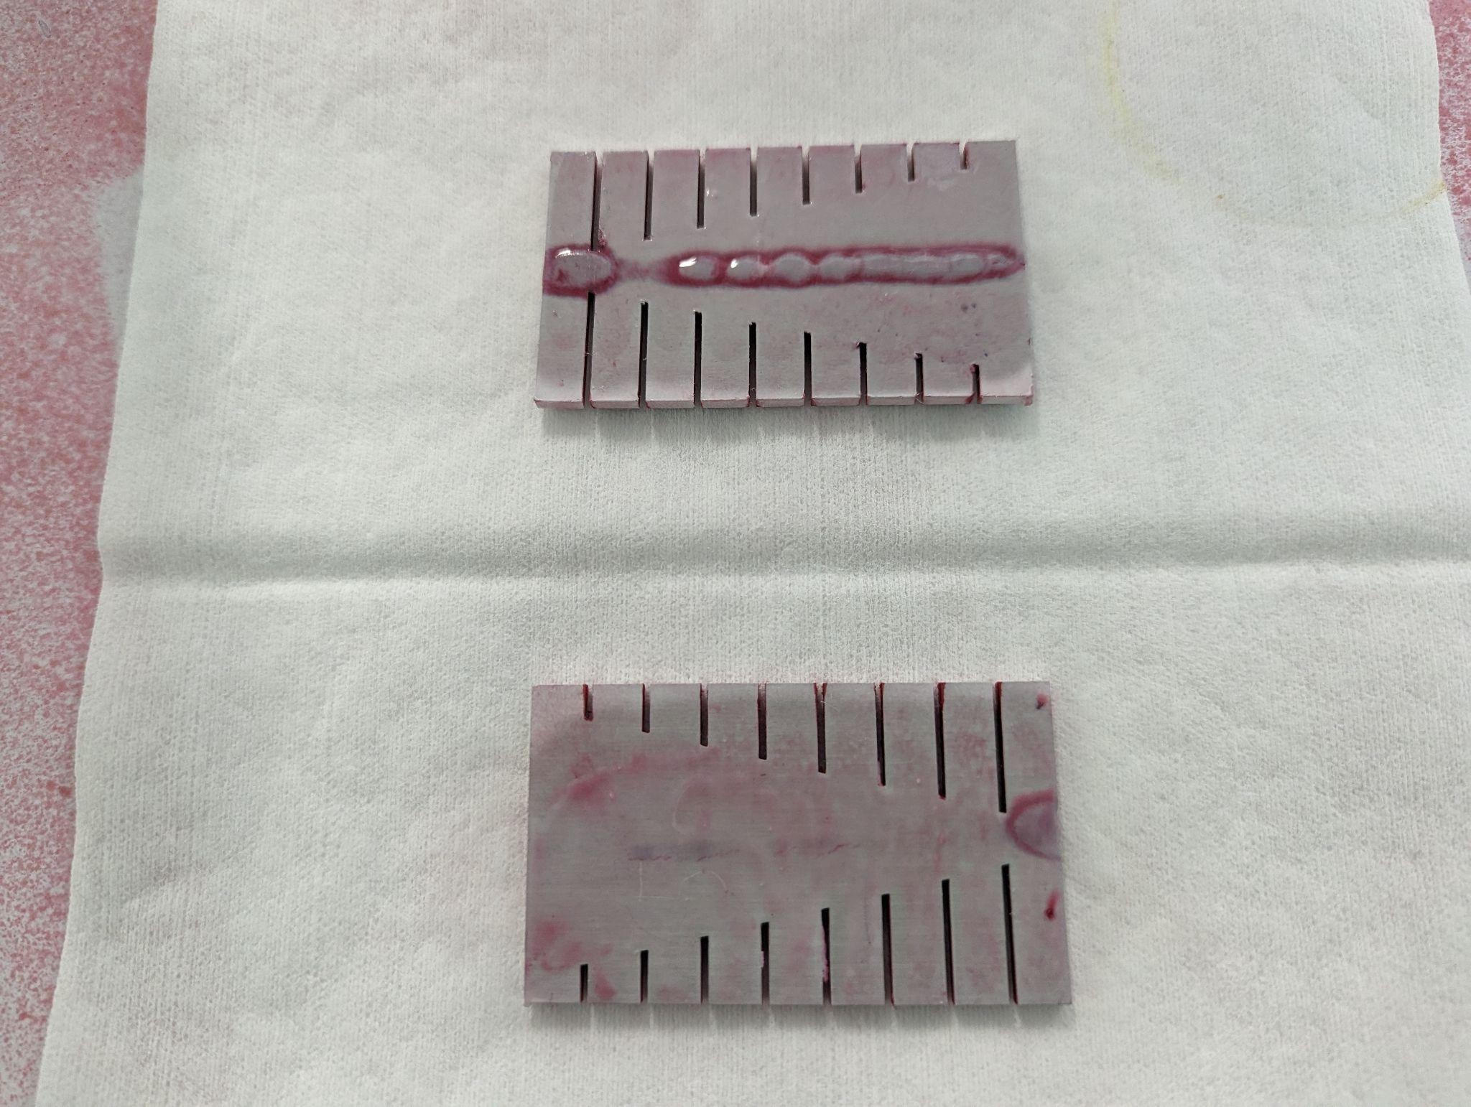
Dye Penetrant Testing (PT)
The process of using a dye or liquid to coat material and then look for breaks in the liquid to identify imperfections.
Notes:
https://www.flyability.com/dye-penetrant

Slide 13

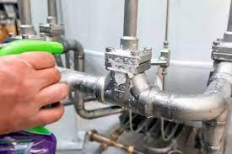
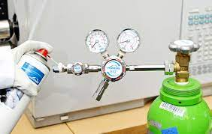
Leak Testing (LT)
Uses pressure to find the presence of defects in an object that are causing leaks.
Notes:
https://www.flyability.com/leak-testing

Slide 14
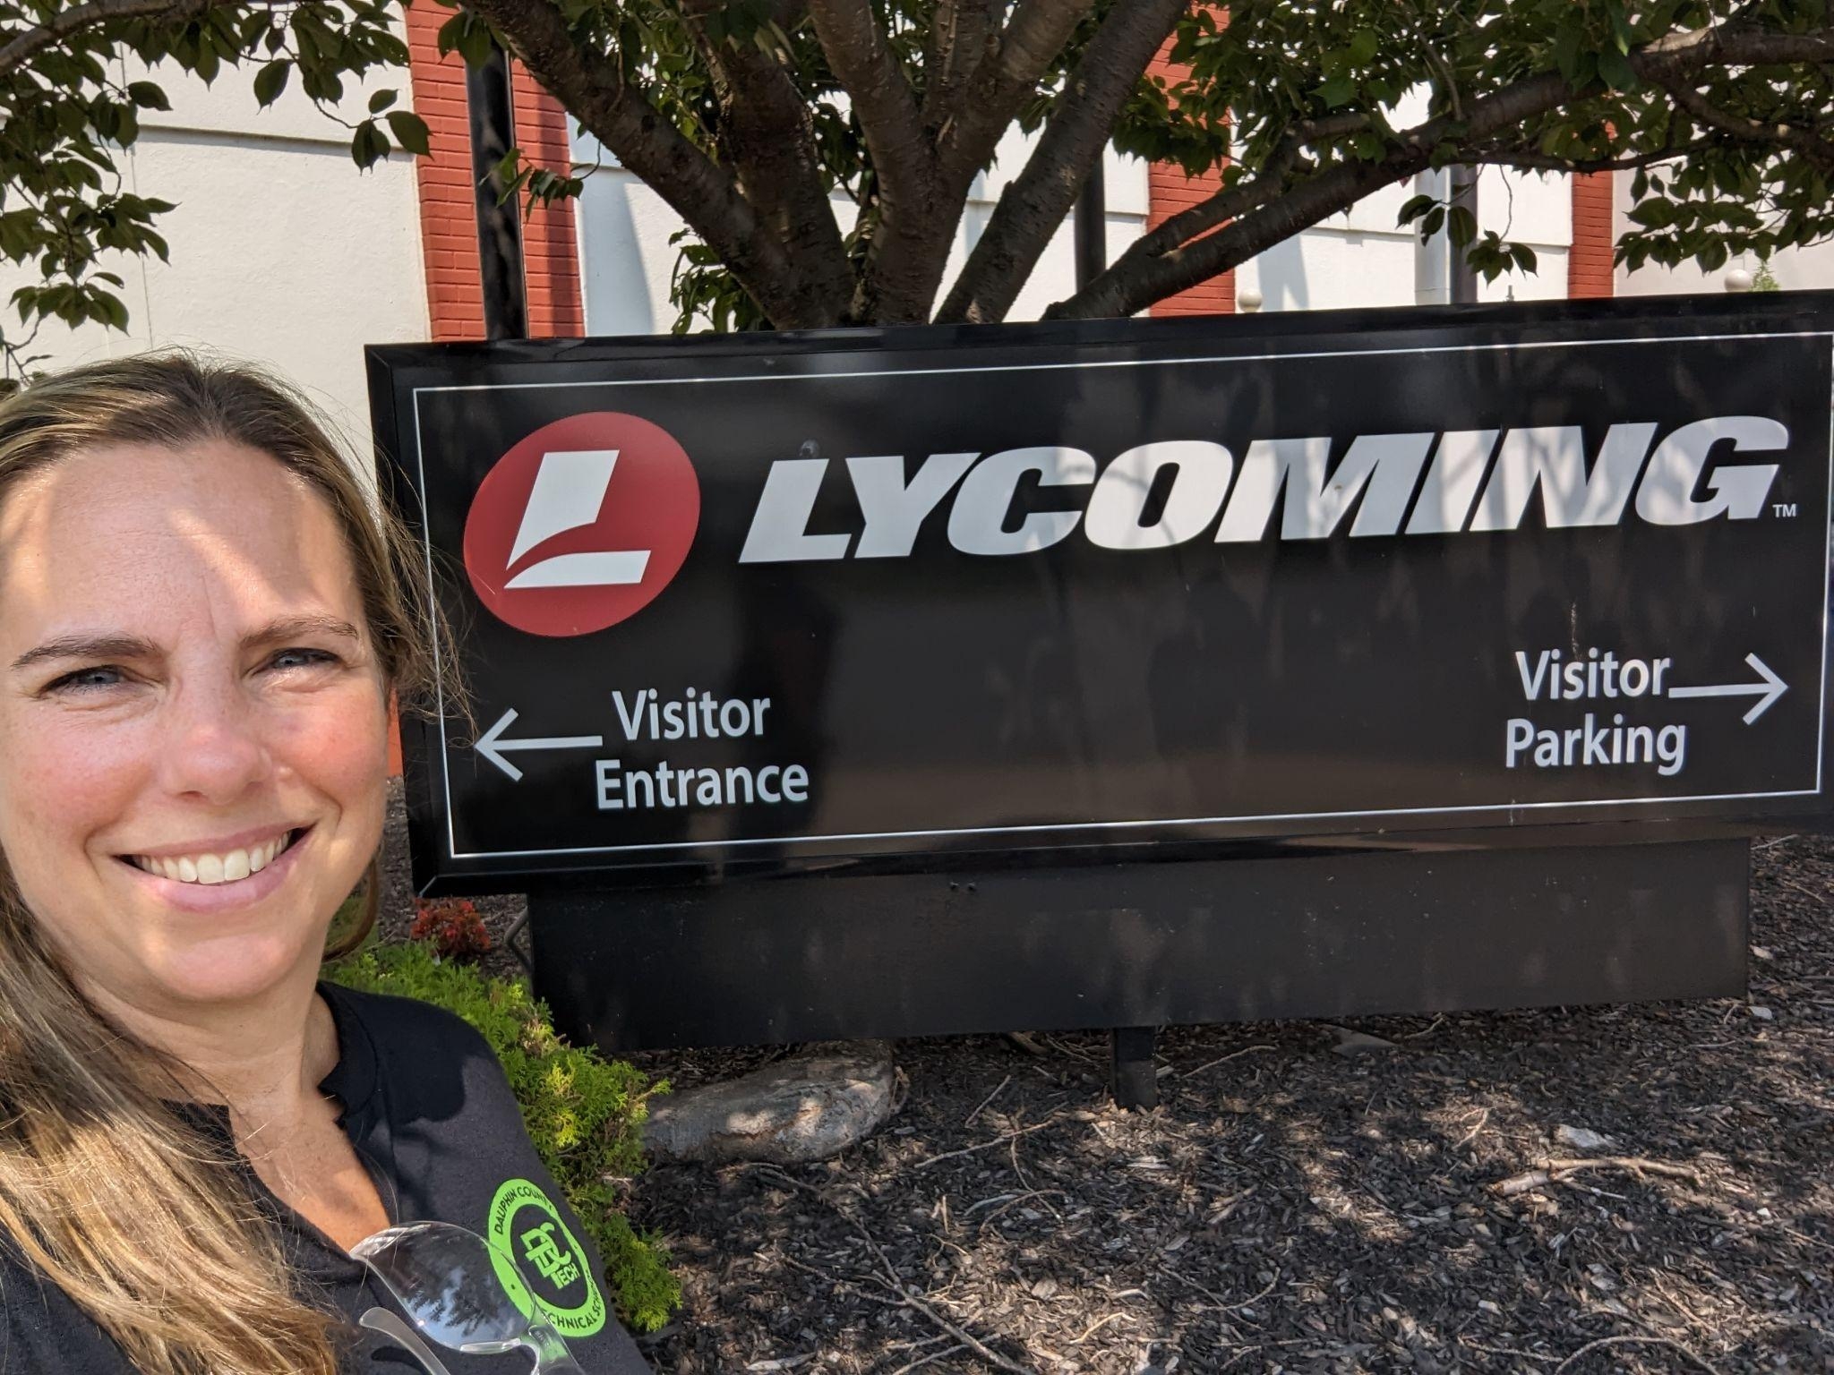
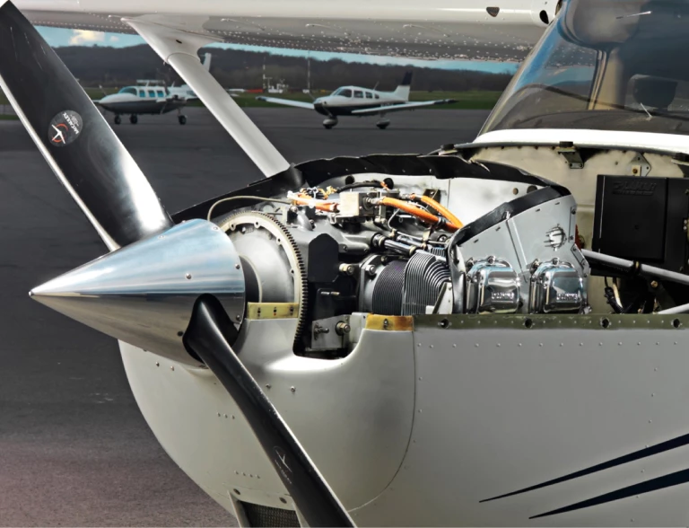
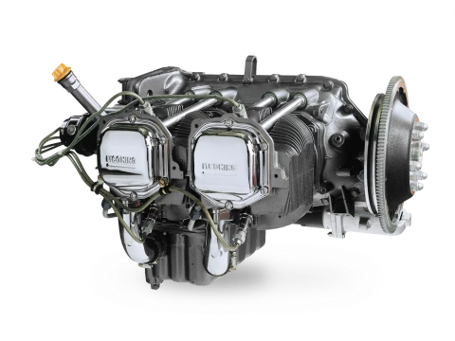
Lycoming Engines
Notes:
https://www.lycoming.com/services

Slide 15
Aviation Maintenance Technician
Overall employment of aircraft and avionics equipment mechanics and technicians is projected to grow 4% form 2022 to 2032.
2022 median pay was $70,740 per year or $34.01 per hour
U.S. Bureau of Labor Statistics for Aircraft and Avionics Equipment Mechanics and Technicians
Aviation Maintenance Technician Program at Pennsylvania College of Technology Tech
Aviation Maintenance Technician Curriculum

